Slide 1


Plural is not “+3rd person”
Jolijn Sonnaert
KU Leuven - CRISSP
jolijn.sonnaert@kuleuven.be
Notes:
short intro kite

Slide 2
The Literature on Person
 | SG |  |  | PL
1st | I |  |  | we
2nd | you |  |  | you
3rd | he, she, it |  |  | they

Slide 3
The Literature on Person
 | SG | Cysouw 2009 |  | PL | Cysouw 2009
1st | I | 1 |  | we | 1+3
2nd | you | 2 |  | you | 2+3
3rd | he, she, it | 3 |  | they | 3+3

Slide 4
The Literature on Person
HANDOUT (9)
 | SG | Cysouw 2009 | Harbour 2016 | PL | Cysouw2009 | Harbour 2016
1st | I | 1 | i | we | 1+3 | i_{o}
2nd | you | 2 | u | you | 2+3 | u_{o}
3rd | he, she, it | 3 | o | they | 3+3 | o_{o}

Slide 5
The Literature on Person
 | SG | Cysouw 2009 | Harbour 2016 | PL | Cysouw 2009 | Harbour 2016
1st | I | 1 | i | we | 1+3 | i_{o}
2nd | you | 2 | u | you | 2+3 | u_{o}
3rd | he, she, it | 3 | o | they | 3+3 | o_{o}
Common analysis:
PLURAL = + 3rd PERSON

Slide 6
Claim
PLURAL ≠ 3rd PERSON
PL = a associates
3rd = o other
DIFFERENT morphologically and semantically
 | SG |  | PL
1 | I | i | we | ia
2 | you | u | you | ua
3 | he, she, it | o | they | oa

Slide 7
Outline
Framework and Background
The Problem & Claim
Morphological Differences
Semantical Differences
Conclusion
Questions

Slide 8
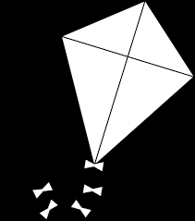
Outline
Framework and Background
The Problem & Claim
Morphological Differences
Semantic Differences
Conclusion
Questions

Slide 9
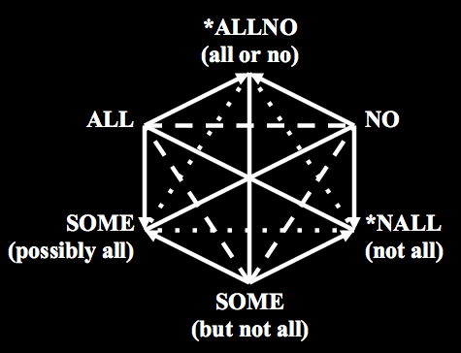
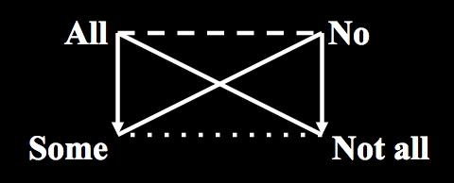
The Kite Framework
HANDOUT (1) & (2)
1. Framework and Background
Jacoby, Sesmat, Blanché 1952
Notes:
Account for ambiguity some → second some
Finish contradiction: allno

Slide 10
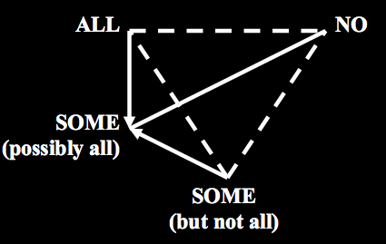
The Kite Framework
HANDOUT (2) & (3)
1. Framework and Background
Lexicalisation in certain closed lexical fields is restricted by a concept formation constraint (Jaspers 2012, Seuren & Jaspers 2014):
Logical hexagon:
two corners are
never lexicalised
Result: kite structure
Notes:
RESTRICTION

Slide 11
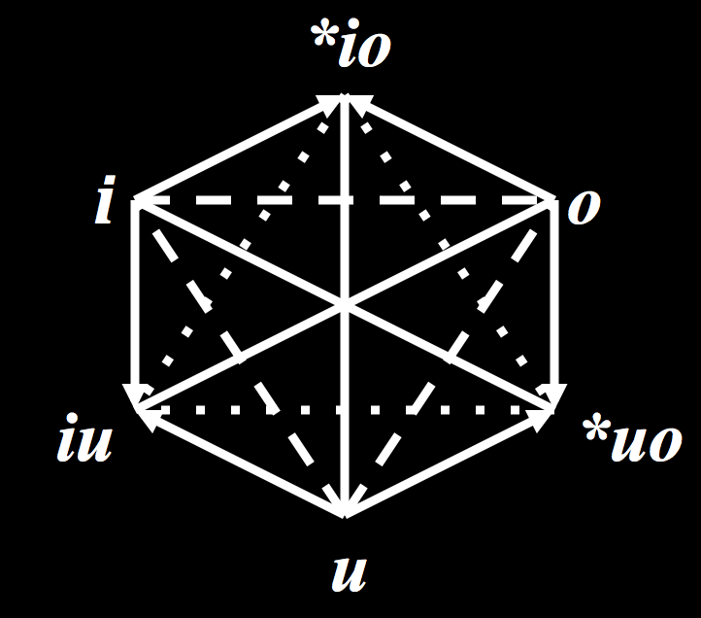
Person
HANDOUT (4)
1. Framework and Background
Person deixis: corresponding limitations on concept formation
1st & 3rd
1st person
3rd person
inclusive
2nd & 3rd
2nd person

Slide 12
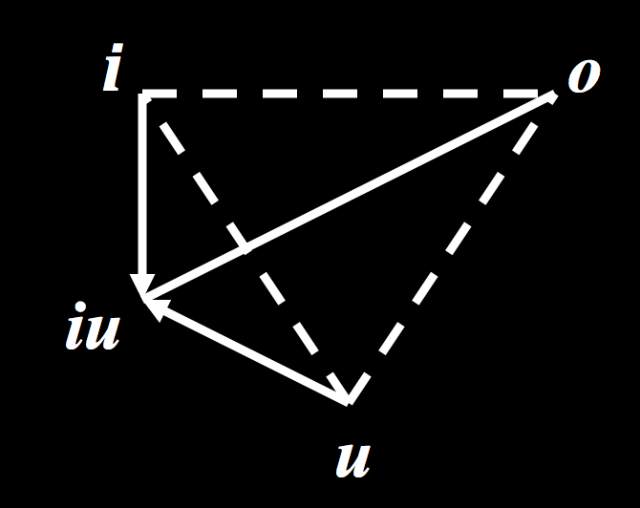
HANDOUT (5)
1. Framework and Background
Person deixis: corresponding limitations on concept formation
1st person
3rd person
inclusive
2nd person

Slide 13
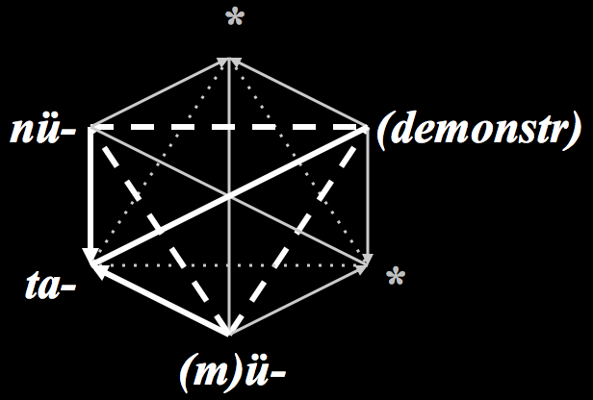
Tümpisa Shoshone
HANDOUT (10) & (6)
1. Framework and Background
Dayley 1989
 | SG | PL
iu |  | ta-mmü
i | nü | nü-mmü
u | ü | mü-mmü
o | (Demonstratives)

Slide 14
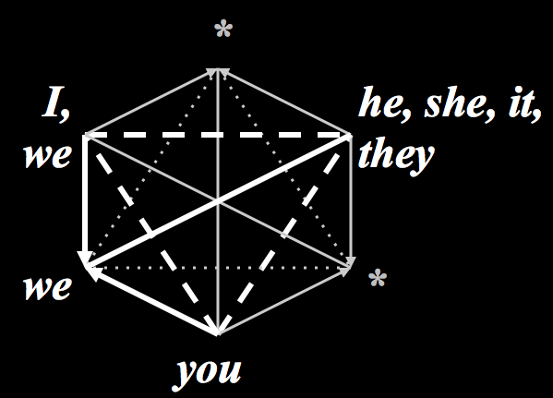
English
HANDOUT (7)
1. Framework and Background
 | sg | pl
iu |  | we
i | I | we
u | you | you
o | he, she, it | they
Notes:
kite: 2 proper parthood
1 contradiciton
triangle of contrariety
Completely in line with kites for quantifiers, colour, pred log operators, adjectives,…

Slide 15

Outline
Framework and Background
The Problem & Claim
Morphological Differences
Semantical Differences
Conclusion
Questions

Slide 16
The Literature on Person
HANDOUT (9)
2. Problem and Claim
Common analyses:
PLURAL = + 3rd PERSON
 | SG |  | PL
 | Cysouw 2009 | Harbour 2016 | Cysouw 2009 | Harbour 2016
inclusive | - | - | 1+2(+3) | iu_{o}
speaker | 1 | i | 1+3 | i_{o}
hearer | 2 | u | 2+3 | u_{o}
non-part | 3 | o | 3+3 | o_{o}

Slide 17
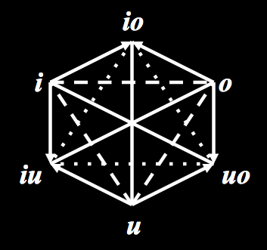
2. The Problem
2. Problem and Claim
If we assume
PL = 3rd
Result:
Lexicalisation of
  io
  uo
= 1pl
= 2pl
Notes:
Very important for this analysis: 3rd p NOT same as pl

Slide 18
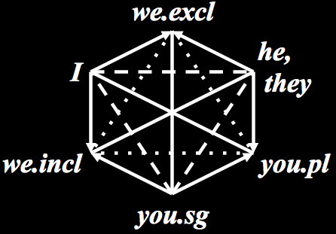
2. Problem and Claim
If we assume
PL = 3rd
Result:
Lexicalisation of
  io
  uo
Notes:
Very important for this analysis: 3rd p NOT same as pl

Slide 19
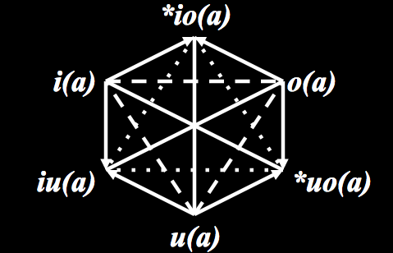
Claim
HANDOUT (8)
2. Problem and Claim
PLURAL ≠ 3rd PERSON
DIFFERENT
morphologically
semantically

Slide 20
Outline
Framework and Background
The Problem & Claim
Morphological Differences
Semantic Differences
Conclusion
Questions

Slide 21
3. Morphology
3. Morphological Differences
Possible Person Paradigms:
Suppletive paradigm
Regular person stem + number affix
Suppletive person stem + number affix

Slide 22
HANDOUT (11)
3. Morphological Differences
Suppletive paradigm (Guaraní):
Gregores & Suárez 1967
 | SG | PL
iu |  | yané
i | šé | oré
u | né | peé
o | (demonstr)

Slide 23
HANDOUT (12)
3. Morphological Differences
Suppletive paradigm (Guaraní)
Regular person stem + number affix (Quechua):
Adelaar 1977
 | SG | PL
iu |  | nuxañči(k)
i | nuxa | nuxa:-guna
u | xam | xam-guna
o | pay | pay-guna

Slide 24
HANDOUT (13)
3. Morphological Differences
Suppletive paradigm (Guaraní)
Regular person stem + number affix (Quechua)
Suppletive person stem + number affix: (Kayardild):
Evans 1995
 | SG | PL
iu |  | nga-ku-l-da
i | nga-da | nga-l-da
u | nyingka | ki-l-da
o | niya | bi-l-da

Slide 25
3. Morphological Differences
Suppletive paradigm (Guaraní)
Regular person stem + number affix (Quechua)
Suppletive person stem + number affix (Kayardild)
➔ Compositional paradigms

Slide 26
Expectation:
3. Morphological Differences
Expectation for compositional paradigms:
Languages that share one morpheme for
3rd & plural number affix
 | sg | pl
iu |  | α-δ
i | β | β-δ
u | γ | γ-δ
o | δ | δ
Tümpisa Shoshone
iu |  | ta-mmü
i | nü | nü-mmü
u | ü | mü-mmü
o | (Demonstratives)

Slide 27
Claim:
3. Morphological Differences
Sample (39 lgs)
Typological literature,
a.o: (330 lgs)
  Forchheimer 1953
  Harley & Ritter 2003
  Daniel 2005
  Baerman et al. 2005
  Bobaljik 2008
  Cysouw 2009
  Harbour 2016
  Ackema & Neeleman 2016
Unattested
 | sg | pl
iu |  | α-δ
i | β | β-δ
u | γ | γ-δ
o | δ | δ

Slide 28
Composite Forms in Forchheimer 1953
3. Morphological Differences
Forchheimer 1953: The Category of Person in Language
→ ‘Composite Forms’: +3
Pama-Nyungan:
  Kalaw Lagaw Ya
  Arrernte
Penutian
  Coastal Oregon Penutian
    Coos
    Siuslaw
  Chinook
Ancient Middle-East, Mesopotamia
  Hurrian
  Sumerian
Notes:
Work in progress: mostly straightforward reanalysis, some challenging cases: Sumerian and Chinook

Slide 29
Siuslaw
HANDOUT (14)
3. Morphological Differences
Pronominal suffixes in Forchheimer 1953
 | SG | DU | PL
iu |  | -ns | -nl
i | -n | -a(^{u})xûn | -nxan
u | -nx | -ts | -tcî
o | ø | -a^{u}x | -nx

Slide 30
Siuslaw
HANDOUT (14)
3. Morphological Differences
Pronominal suffixes in Forchheimer 1953
 | SG | DU | PL
iu |  | -ns | -nl
i | -n | -a(^{u})xûn | -nxan
u | -nx | -ts | -tcî
o | ø | a^{u}x | -nx

Slide 31
Siuslaw
HANDOUT (14)
3. Morphological Differences
Pronominal suffixes in Forchheimer 1953
 | SG | DU | PL
iu |  | -ns | -nl
i | -n | -a(^{u})xûn | -nxan
u | -nx | -ts | -tcî
o | ø | a^{u}x | -nx
“[T]he inclusive forms are clearly composed of the third personal suffixes of the respective numbers and the n of the first person plus auxiliary vowel”
(Forchheimer 1953 p. 109)

Slide 32
Siuslaw
HANDOUT (14)
3. Morphological Differences
Reanalysis:
 | SG | DU | PL
iu |  | -ns | -nl
i | -n | -a(^{u})x-ûn | -nx-an
u | -nx | -ts | -tcî
o | ø | -a^{u}x-ø | -nx-ø
-n = 1
-ø = 3
-a^{u}x-
= DU
-nx-
= PL
Notes:
! nx 2de enk: accidentele homofonie!

Slide 33
Chinook
HANDOUT (15)
3. Morphological Differences
Pronominal prefixes in Forchheimer 1953
 | SG | DU | PL
iu |  | tx- | lx-
i | n- | nt- | ntc-
u | m- | mt- | mc-
o | tc- | (c)t- | t-

Slide 34
Chinook
HANDOUT (15 & 16)
3. Morphological Differences
Pronominal prefixes in Forchheimer 1953
Independent pronouns (Harley & Ritter 2002)
 | SG | DU | PL
iu |  | tx- | lx-
i | n- | nt- | ntc-
u | m- | mt- | mc-
o | tc- | (c)t- | t-
 | SG | DU | PL
iu |  | tx-aika | lx-aika
i | n-aika | nt-aika | ntc-aika
u | m-aika | mt-aika | mc-aika
o | áxka | ct-áxka | táska

Slide 35
Chinook
HANDOUT (15 & 16)
3. Morphological Differences
Pronominal prefixes in Forchheimer 1953
Independent pronouns (Harley & Ritter 2002)
 | SG | DU | PL
iu |  | tx- | lx-
i | n- | nt- | ntc-
u | m- | mt- | mc-
o | tc- | (c)t- | t-
 | SG | DU | PL
iu |  | tx-aika | lx-aika
i | n-aika | nt-aika | ntc-aika
u | m-aika | mt-aika | mc-aika
o | áxka | ct-áxka | táska

Slide 36
Chinook
HANDOUT (15 & 16)
3. Morphological Differences
Pronominal prefixes in Forchheimer 1953
Independent pronouns (Harley & Ritter 2002)
 | SG | DU | PL
iu |  | tx- | lx-
i | n- | nt- | ntc-
u | m- | mt- | mc-
o | tc- | (c)t- | t-
 | SG | DU | PL
iu |  | tx-aika | lx-aika
i | n-aika | nt-aika | ntc-aika
u | m-aika | mt-aika | mc-aika
o | áxka | ct-áxka | táska
Notes:
alternative analysis: tc- is palatal sibilant affricate
-c- on 1st and 2nd is plural
for 1st: plural c on dual 1st
for 2nd: plural c on sg 2nd

Slide 37
Summary
3. Morphological Differences
There are no convincing examples of languages that use the same morpheme for
PL
3rd
➔ PL ≠ 3rd
 | sg | pl
iu |  | α-δ
i | β | β-δ
u | γ | γ-δ
o | δ | δ

Slide 38
Outline
Framework and Background
The Problem & Claim
Morphological Differences
Semantic Differences
Conclusion
Questions

Slide 39
Semantic differences
4. Semantic Differences
Reference: (Ackema & Neeleman to appear, pp. 70-73)
  “An o … cannot be included in the reference of a … plural pronoun without first being turned into an associate in some way.”

Slide 40
Survey
4. Semantic Differences
No associate relation:
Peter and Ad are watching a movie starring George Clooney. Peter asks Ad: “Do you know if George Clooney likes to drink coffee?” To which Ad answers:
“Yes, we both like to drink Nespresso.”
“Yes, he likes to drink Nespresso, just like I do.”
2.44/5
4.18/5

Slide 41
4. Semantic Differences
Associate relation
Peter and Ad are watching a movie starring George Clooney. Ad tells Peter how he and George Clooney go for a walk together every Sunday, they have been friends for years.
Peter asks Ad: “Do you know if George Clooney likes to drink coffee?” To which Ad answers:
“Yes, we both like to drink Nespresso.”
“Yes, he likes to drink Nespresso, just like I do.”
2.44/5
3.83/5
4.41/5
Notes:
ALSO FOR SECOND AND THIRD!

Slide 42
Summary
4. Semantic Differences
A plural pronoun
  Does NOT include reference to a third person
  Includes reference to associates

Slide 43

Outline
Framework and Background
The Problem & Claim
Morphological Differences
Semantic Differences
Conclusion
Questions

Slide 44
Conclusion
5. Conclusion
Morphology: Different morphemes for 3rd person and plural
Semantics: Reference
3rd person: o
≠
Plural: a

Slide 45
5. Conclusion
The Concept Formation Constraint correctly predicts iu to be the only lexicalisable combination of person atoms.

Slide 46


