Slide 1

Deficient subject agreement in complement clauses in Russian Sign Language: logophoric analysis
Khristoforova Evgeniia
University of Amsterdam
BCGL 2020

Slide 2
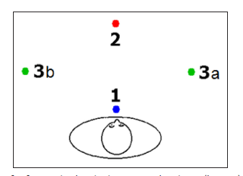
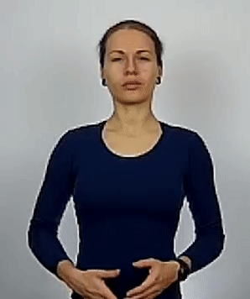
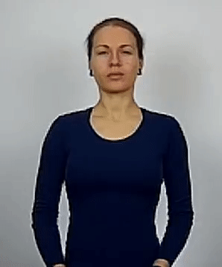
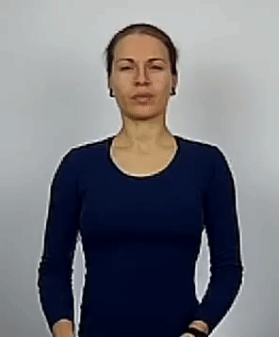
Agreement in sign languages (SL): brief intro
1-help-2
2-help-1
3a-help-3b
Agreement in SL is realized via the direction of the motion in verbal signs; start and end points of the movement encode person features of the arguments:
the body of the signer – 1st person;
the front – 2^{d} person;
the right and on the – 3^{d} person.
“I help you”
“You help me”
“He/she help him/her”
Pfau et al. (2018 ): traditional analysis of agreement in spoken languages can be applied to sign language agreement.

Slide 3
Background: corpus findings
try, love and want select for a special type of complement clauses:
no overt embedded subjects
no overt complementizer
<…>
subject agreement on the embedded predicate is 1st person
BOY 3-HELP FRIEND simple clause
Boy helps a friend
BOY WANT 1-HELP FRIEND complement clause
Boy wants to help a friend

Slide 4
Subject agreement in complement clauses: experimental set up
Grammaticality judgment tests:
BOY WANT 1-HELP FRIEND
BOY_{3a} WANT 3a-HELP-3b FRIEND_{3b}
Methodology
try, love, want combined with three diffrent agreeing predicates each
6 participants
Procedure
replicate the stimulus
evaluate it on a 5-point Likert scale
propose correction

Slide 5
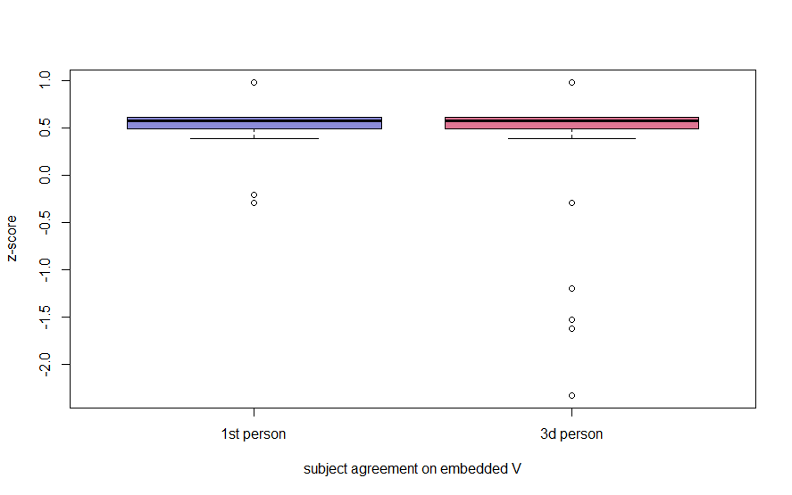
Subject agreement in complement clauses: grammaticality judgment results
1st person subject agreement is acceptable for all signers (mean = 4,5; sd = 0,63); scores <4 from one signers
3^{d} person subject agreement is also acceptable but with less cohesion in judgments (mean = 4.4; sd = 1,7); scores <4 come from three signers
Participants often failed to replicate 3-V correctly and produced 1-V instead
BOY WANT 1-HELP FRIEND
BOY WANT 3a-HELP-3b FRIEND
Corpus results confirmed by GJT

Slide 6
Possible analysis:
control analysis
indexical shift
logophoricity account: null 1st person logophor
1st person subject agreement in sentential complements of try, want, and love is licensed by a null 1st person logophor in a subject position of an embedded clause.

Slide 7
Possible analysis:
control analysis
indexical shift
logophoricity account: null 1st person logophor

Slide 8

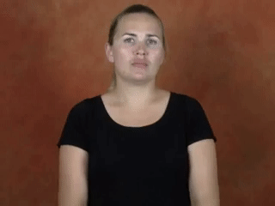
Control analysis?
BOY WANT [ PRO Ø-HELP FRIEND]_{CP}
Embedded predicates in control do not usually agree
and our predicates definitely do:
Default 1st person subject agreement is typologically unusual (see Ackema & Neeleman (2019) for 3^{d} person as default).
1st person subject agreement
Uninflected (nominalized) form

Slide 9
Possible analysis:
control analysis
indexical shift
logophoricity account: null 1st person logophor

Slide 10
Indexical shift analysis?
context shift
BOY_{i} WANT [ OP_{auth} pro_{i} 1-HELP poss-1 FRIEND]_{CP}
(Anand 2006)
Under indexical shift account we expect all co-indexed pronominal elements inside the embedded clause to shift their interpretation:
BOY_{i} WANT 1-HELP poss-1_{i} FRIEND
Expected interpretation:
The boy wants to help his (boy’s own) friend
Shift Together constraint:
“All indexicals within a speech-context domain must pick up reference from the same context.”
(Anand & Nevis 2004)

Slide 11
Indexical shift tested: possessive pronouns inside a complement clause
BOY WANT 1-HELP poss-1 FRIEND
Boy_{i} wants to help signer’s/*his_{i} friend
BOY WANT 1-HELP poss-3 FRIEND
Boy_{i} wants to help his_{i/j} friend
Possessive pronouns modifying embedded objects never get a shifted interpretation.

Slide 12
Possible analysis:
control analysis
indexical shift
logophoricity account: null 1st person logophor

Slide 13
Logophoric analysis
[ Subj_{i} …. [_{CP} OP^{log} Comp [… LOG_{i}… poss…]]
Amends feature inside the embedded clause:
a plain pronoun remains unbound by OP^{log} as in Edo and Yoruba
control
binding
(Koopman and Sportiche 1989)
(Edo)
Ozo_{i} hoo ne írẹ̀n_{i} tie ebe ẹ̀re_{i}.
Ozo want C LOG read book his
“Ozo wants to read his book”.
(Yoruba)
Ade_{i} sọ pe oun_{i} ti ri we ẹ̀_{i}
Ade say that LOG ASP see book his
Ade said that he has seen his book.
BOY_{i} WANT [_{CP} OP^{log} [LOG_{i} 1-HELP poss-3_{i} FRIEND]]
(Baker 2020)

Slide 14

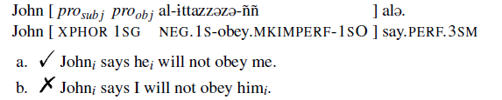
1st person logophors across languages
Amharic
(Deal 2018: 75)

Slide 15
Proposed structure
TP
try, love and want in Russian Sign Language select for complement clauses with a null 1st person logophor in embedded subject position.
Subj_{i} [Ф:3]
VP
try/love/want
CP
OP^{log}
TP
control
LOG [1]
T’
binding
[uФ:1]
vP
Agree
v’
LOG [1]
V [uInfl: 1]
VP
V O

Slide 16
References
Ackema, P. and Neeleman, A. 2019. Processing Differences Between Person and Number: A Theoretical Interpretation. Frontiers in Psychology 10. https://doi.org/10.3389/fpsyg.2019.00211.
Anand, P. and Nevins, A. 2004. Shifty operators in changing contexts. Proceedings of Semantics and Linguistic Theory XIV, 20–37. Ithaca, NY: CLC Publications.
Anand, P. 2006. De de se. MIT: Ph.D. dissertation.
Baker, M. C. 2020. On Logophoric Pronouns in African Languages: Universals, Variation, and Larger Comparisons. [Conference presentation] TMP 2020, Moscow
Deal A. R. 2018. Indexiphors: Notes on embedded indexicals, shifty agreement, and logophoricity. UMOP 40: The Leader of the Pack: A Festschrift in Honor of Peggy Speas, 59–86. GLSA Amherst.
Culy, C. 1994. A note on logophoricity in Dogon. Journal of African languages and linguistics 15: 113–125.
Koopman, H. and Sportiche, D. 1989. Pronouns, logical variables, and logophoricity in Abe. Linguistic Inquiry 20: 555-589.
Pfau, R., Salzmann, M. and Steinbach, M. 2018. The Syntax of Sign Language Agreement: Common Ingredients, but Unusual Recipe. Glossa: A Journal of General Linguistics 3: 107. 1-46.

