Slide 1
Morphology beyond the generative ideal
s in
Jenny Audring PoP workshop Leuven 26 May, 2021

Slide 2
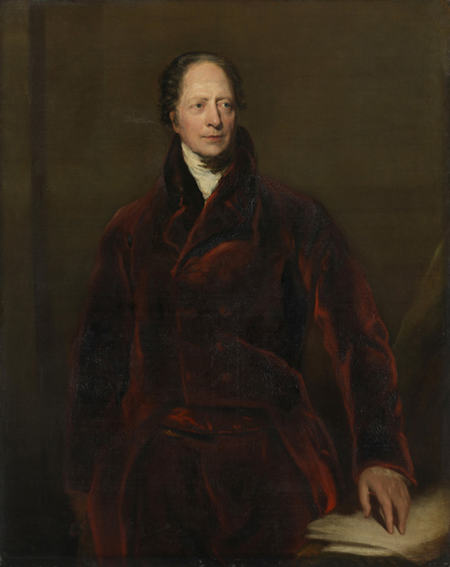
A science of rules
Linguistics is traditionally a science of rules
Von Humboldt: “infinite use of finite means”
Generative potential of language at the top of the research agenda

Slide 3
A science of rules
Generative framework: morphology should be about possible words
Is morphological theory responsible for the actual words of a language?
Actual words are of theoretical interest
Present a theory in which actual words have pride of place

Slide 4
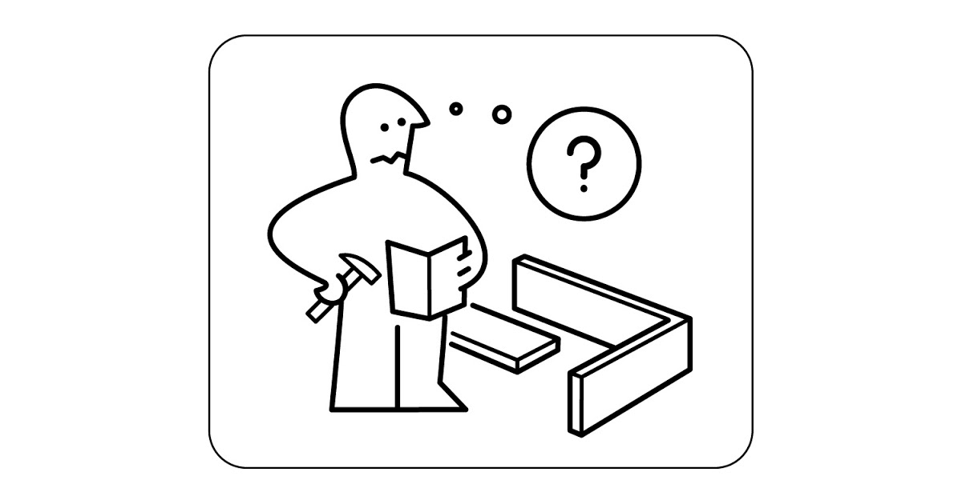
Unproductive morphology

Slide 5
Unproductive morphology
Morphological patterns not easily available for active use
Complex words that cannot be formed online
  Parts are unavailable
  Parts/whole word have unpredictable meaning
  Parts/whole word have unpredictable form

Slide 6
Unproductive morphology
Morphological patterns not easily available for active use
Complex words that cannot be formed online
  Parts are unavailable
  Parts/whole word have unpredictable meaning
  Parts/whole word have unpredictable form

Slide 7
Parts not available

Slide 8
Parts not available
Compounding: cranberry morphs
English
cranberry, werewolf, mermaid, twilight, cobweb, lukewarm, iceberg

Slide 9
Parts not available
Derivation: bound roots
English
ugly, unkempt, reckless, ruthless, plumber, carpenter
Dutch and German
Sprookje, Märchen ‘fairytale’

Slide 10
Parts not available
Derivation: affixes combining with bound roots
English [X -le]_{V}
spark-le, nest-le, crack-le, crumb-le
amble, baffle, boggle, burble, ...

Slide 11
Parts not available
Derivation: affixes combining with bound roots
English [X -id]_{A} ~ [X -or]_{N}
candid – candor splendid – splendor
fervid – fervor pallid – pallor (pale?)
horrid – horror squalid – squalor
languid – languor torpid – torpor
(possibly) stupid – stupor (possibly) liquid – liquor

Slide 12
Parts not available
Derivation: (near) hapax affixes
English
laughter, bombard, heroine, comparison, bishopric, hatred, knowledge

Slide 13
Parts not available
Derivation: (near) hapax affixes
English [X -rel]_{N}
scoundrel, wastrel, perhaps mongrel
German [X -icht]_{N}
Dickicht ‘thicket’, Röhricht ‘cane brake’, Kehricht ‘sweepings’

Slide 14
Unpredictable meaning

Slide 15
Unpredictable meaning
Compounding: strawberry morphs*
English:
strawberry, raspberry, tea cozy, sheepfold,
sidekick, airplane, chestnut
*Jackendoff (2010: 425)

Slide 16
Unpredictable meaning
Derivation: strawberry morphs*
English:
gorgeous, rubbish, vanish, adultery, ungainly
*Jackendoff (2010: 425)

Slide 17
Unpredictable meaning
Morphological idioms
Compounding, English: honeymoon, understand, ...
Derivation, Dutch: telefoontje ‘phone call’, oortjes ‘ear buds’
Inflection, English: looks, brains, manners, minutes, premises, bangs
Inflection, Norwegian (Bokmål): finnes ‘exist’

Slide 18
Unpredictable form

Slide 19
Unpredictable form
Stem allomorphy
English: tooth – teeth, strong – strength, foul – filth, proud – pride
German: sprechen ‘speak’ – Sprache ‘language’, tun ‘do’ – Tat ‘deed’

Slide 20
Unpredictable form
Suppletion*
Inflection: good – better, bad – worse, is – are
Derivation:**
mouth – or-al cat – fel-ine
heart – card-iac dog – can-ine
ear – audit-ive/audit-ory cattle – bov-ine
king – roy-al bear – urs-ine
sun – sol-ar monkey – sim-ian
* Corbett (2007) ** some examples from Štekauer (2014)

Slide 21
Unpredictable form
Affix allomorphy
Lexical plurals, German:*
Grund ‘reason’– Gründe
Hund ‘dog’ – Hunde
Mund ‘mouth’ – Münder
* Kürschner (2006)

Slide 22
Procedure not available

Slide 23
Procedure not available
Unproductive patterns
English [N -en]_{A}
earthen, silken, wooden, golden, ashen, ...
English [X -ern]_{A}
eastern, western, northern, southern

Slide 24
Procedure not available
Unproductive patterns can be large!
-ter | -icht | -ish_{V} | -(e)lijk_{A} | -ing
laughter | Dickicht Röhrich Kehricht | cherish publish vanish | sterfelijk ‘mortal’ mannelijk ‘male’ lieflijk ‘lovely’ | running
1-2 | 3-5 | ~40 | ~400 | ∞

Slide 25
Unproductive morphology

Slide 26
Unproductive morphology
All of these cases involve a mixture of idiosyncrasy (lexicon) and regularity (grammar)

Slide 27
Unproductive morphology
All of these cases need to be listed but not without internal structure

Slide 28
Morphological theory
Is morphological complexity a matter of degree? (bak-er vs. carpent-?er)
Does the grammar care?
Where does morphology end and phonology begin?
How do we model relations like [X -id]_{A} ~ [X -or]_{N}?
How do we model the relation between words like good and better?

Slide 29
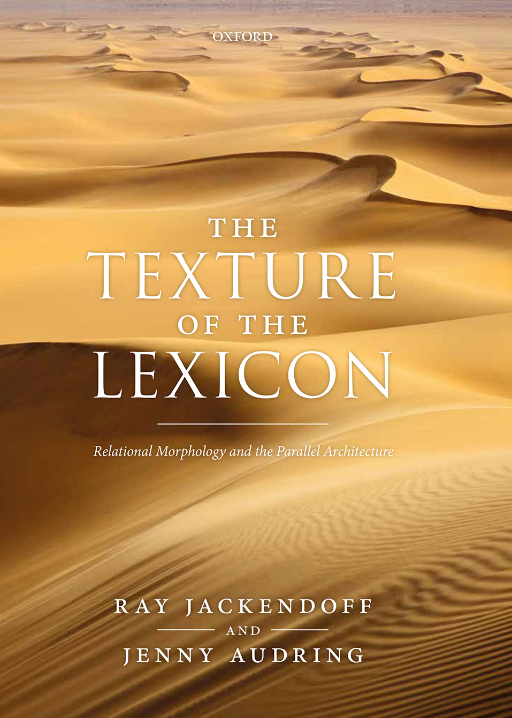
“Relational Morphology”
Joint work with Ray Jackendoff (Tufts/ MIT)
Sister theory of “Construction Morphology” (Booij 2010)

Slide 30
“Relational Morphology”
Semantics: [PERSON WHO READ]
Morphosyntax: [_{N} V suff]
Phonology: /riːdə/
Orthography: <reader>

Slide 31
“Relational Morphology”
Semantics: [PERSON WHO READ]₁
Morphosyntax: [_{N} V suff]₁
Phonology: /riːdə/₁
Orthography: <reader>₁
Associated structure: Interface links

Slide 32
“Relational Morphology”
Semantics: [PERSON WHO READ]₁ [READ]₂
Morphosyntax: [_{N} V suff]₁ [V]₂
Phonology: /riːdə/₁ /riːd/₂
Orthography: <reader>₁ <read>₂
Associated structure: Interface links

Slide 33
“Relational Morphology”
Semantics: [PERSON WHO READ₂]₁ [READ]₂
Morphosyntax: [_{N} V₂ suff]₁ [V]₂
Phonology: /riːd₂ə/₁ /riːd/₂
Orthography: <read₂er>₁ <read>₂
Same structure: Relational links

Slide 34
“Relational Morphology”
Semantics: [PERSON WHO READ₂]₁ [READ]₂
Morphosyntax: [_{N} V₂ suff₃]₁ [V]₂
Phonology: /riːd₂ə₃/₁ /riːd/₂
Orthography: <read₂er₃>₁ <read>₂
Same structure: Relational links

Slide 35
“Relational Morphology”
Semantics: [PERSON WHO READ₂]₁ [READ]₂
Morphosyntax: [_{N} V₂ suff₃]₁ [V]₂
Phonology: /riːd₂ə₃/₁ /riːd/₂
Orthography: <read₂er₃>₁ <read>₂
Same structure: Relational links
Shortcut notation: [read_{V} -er]_{N} ‘Person who reads’

Slide 36
“Relational Morphology”
[V -er]_{N}
‘Person who Xs’
[read_{V} -er]_{N} [speak_{V} -er]_{N} [teach_{V} -er]_{N}
‘Person who reads’ ‘Person who speaks’ ‘Person who teaches’

Slide 37
“Relational Morphology”
[V -er]_{N} Schema
‘Person who Xs’
[read_{V} -er]_{N} [speak_{V} -er]_{N} [teach_{V} -er]_{N}
‘Person who reads’ ‘Person who speaks’ ‘Person who teaches’

Slide 38
“Relational Morphology”
Schemas replace rules of grammar (also for syntax: Construction Grammar)
They are not procedures (add/replace/...) but generalizations over known words
Not automatically committed to productivity

Slide 39
“Relational Morphology”
[V -er]_{N}
‘Person who Xs’
[read_{V} -er]_{N} [speak_{V} -er]_{N} [teach_{V} -er]_{N}
‘Person who reads’ ‘Person who speaks’ ‘Person who teaches’
“The structure of these
words is not arbitrary”

Slide 40
“Relational Morphology”
[V -er]_{N}
‘Person who Xs’
[read_{V} -er]_{N} [speak_{V} -er]_{N} [teach_{V} -er]_{N}
‘Person who reads’ ‘Person who speaks’ ‘Person who teaches’
Motivation (de Saussure 1916)

Slide 41
“Relational Morphology”
Motivation is non-directional
[V -er]_{N}
‘Person who Xs’
[read_{V} -er]_{N} [speak_{V} -er]_{N} [teach_{V} -er]_{N}
‘Person who reads’ ‘Person who speaks’ ‘Person who teaches’
“sister links”

Slide 42
“Relational Morphology”
Motivation can be partial
[V -er]_{N}
‘Person who Xs’
[read_{V} -er]_{N} [plumb -er]_{N} [carpent -er]_{N}
‘Person who reads’ ‘Person who ...’ ‘Person who ...’

Slide 43
“Relational Morphology”
Tools:
Schemas as generalizations
Interface links and relational links, precisely specify what is linked to what
Sister links
(Partial) motivation

Slide 44
“Relational Morphology”
Schemas as generalizations
[N -en]_{A}
earthen, silken, wooden, golden, ashen
[X -ern]_{A}
eastern, western, northern, southern

Slide 45
“Relational Morphology”
Specific interface links: idiomaticity
Semantics: [POST-WEDDING TIME] ₆
Morphosyntax: [_{N} N₄ N₅] ₆
Phonology: /hʌnɪ₄ muːn₅/₆
Orthography: <honey₄moon₅>₆

Slide 46
“Relational Morphology”
Specific relational links: allomorphy
strong and strengthen
good and better
cities and oxen
Linkage in semantics and morphosyntax, but only partially in phonology (or not at all: suppletion)

Slide 47
“Relational Morphology”
Partial motivation: cranberry and strawberry morphs, bound roots:
[A/N-berry_{N}]_{N}
[black_{A}-berry_{N}]_{N} [goose_{N}-berry_{N}]_{N} [straw_{N}-berry_{N}]_{N} [cran-berry_{N}]_{N}
[black]_{A} [goose]_{N} [straw]_{N}

Slide 48
“Relational Morphology”
Sister links: between words, but also between schemas
[X_{x} -or₁₀]_{N} [X_{x} -id₉]_{A}
[horr₇ or₁₀]_{N} [splend₈ or₁₀]_{N} [horr₇ id ₉]_{A} [splend₈ id₉]_{A}
“Second-order schemas” (Booij & Masini 2015)

Slide 49
Integration
So what about productive morphology?

Slide 50
Integration
Productive schemas: open variable
[V -er]_{N}
‘Person who Xs’
[read_{V} -er]_{N} [sleep_{V} -er]_{N} [zoom_{V/N} -er]_{N}
‘Person who reads’ ‘Person who sleeps’ ‘Ps. who uses Zoom’
‘sleeping (car on) train’

Slide 51
Summary
Complex words can show any mixture of regularity and idiosyncrasy
Morphological theory should be able to accommodate such words
Wanted:
a theory that allows for listing of complex words with internal structure
a theory in which lexicon and grammar are integrated comfortably
Schemas have two functions: generation (productive schemas) and motivation (all schemas)
Actual words are of theoretical interest (pace GG)

Slide 52
Bedankt voor uw aandacht

