Slide 1

The productivity of Dutch diminutives
Rosita van Tuijl
Peter Coopmans
Utrecht University
Notes:
In this talk we will take a look at the productivity of Dutch diminutives.
More specifically, we will look at Dutch diminutives in relation to the Tolerance Principle – a computational theory that allows us to determine how many exceptions a linguistic rule can tolerate before this rule becomes unproductive. In this talk we will – by systematically using the TP – attempt to find a productive rule system for the Dutch diminutives.
So, by applying the TP, we may find a productive rule system, and thus provide support for Yang’s approach to the problem of the acquisition of language. And more specifically, gain insights into how Dutch child learners can master Dutch diminutives.

Slide 2
In this talk…
Dutch diminutives
Tolerance Principle
Corpus research
Analysis

Slide 3
Dutch diminutives
-je → hekje ‘small fence’
-tje → lepeltje ‘small spoon’
-kje → koninkje ‘small king’
-pje → raampje ‘small window’
-etje → bruggetje ‘small bridge’

Slide 4
Important features in the diminutive space
Obstruency kat –je (‘cat`) / kam –etje (‘comb`)
Vowel Length raam –pje (‘window`) / ram –etje (‘ram’)
Stress ring –etje (‘ring’) / haring –kje (‘herring’)
Ending with –m boom –pje (‘tree’) / not -m
Ending with –ng koning –kje (‘king’) / not -ng
Booij, G. (1999). The phonology of Dutch (vol. 5). Oxford, United Kingdom: Oxford University Press.
Souman, A. & Gillis, S. (2007). A longitudinal study of the acquisition of diminutives in Dutch. Language acquisition and language disorders, 43 , 183-206.
Notes:
The suffix a noun gets is derived from the morpho-phonological features of the noun. Previous researchers have discussed which features exactly are most important when deciding which suffix a noun gets (relevant references are on the slide). The general consensus among them is that the most relevant features are:
1. Obstruency of the ending of a noun. With an obstruent ending, the appropriate suffix is –je, making `katje’. And for ‘kam’, with the sonorant ending, the suffix is –etje.
2. The second relevant feature is vowel length, the length of the final vowel of a noun. The long vowel in `raam’ results in ‘raampje’, where the short vowel in ‘ram’ makes for ‘rammetje’.
3. And then there is also the stress placement. There is a distinction between words like ‘ring’, which has no penultimate stress, and words like ‘haring’, which does have penultimate stress. This results in the suffixes –etje and –kje respectively.
Finally, there are 4 and 5, which are the more simple features of a noun ending with –m or –ng, that trigger the emergence of –pje and –kje respectively.

Slide 5
Tolerance Principle
Yang, C. (2016). The price of linguistic productivity - How children learn to break the rules of language. Cambridge, Massachusetts: The MIT Press

Slide 6
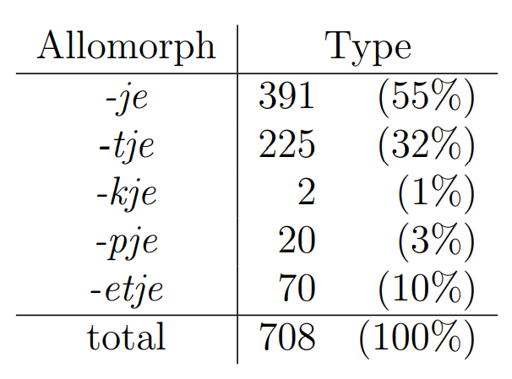
Corpus study
Odijk, J. (2015). Linguistic research with PaQu. Computational Linguistics in The Netherlands, 5 , 3-14.
MacWhinney, B. (2000). The CHILDES Project: Tools for analyzing talk. 3rd edition. Mahwah, USA: Lawrence Erlbaum Associates.
Notes:
We selected all child directed diminutives in a CHILDES database available on PaQu (an online tool to search through large corpora). And for all found diminutives we determined which suffix it received.
On the slide is a table of the frequencies of the different suffixes over the whole set of diminutives, which were all extracted from child directed speech.

Slide 7
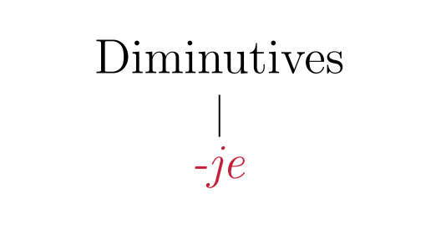





Analysis
Notes:
If a child learner were to look for one rule that defines the whole system, the most logical suffix to use would be the –je suffix, because it is most frequent.
So here we propose the rule, ‘all diminutives end in –je’. In this case, all nouns are diminutivized with –je and nouns ending with other suffixes should be treated as exceptions.
In order to test the productivity of this rule, we take the total amount of nouns that the rule should apply to, which is 708.

Slide 8
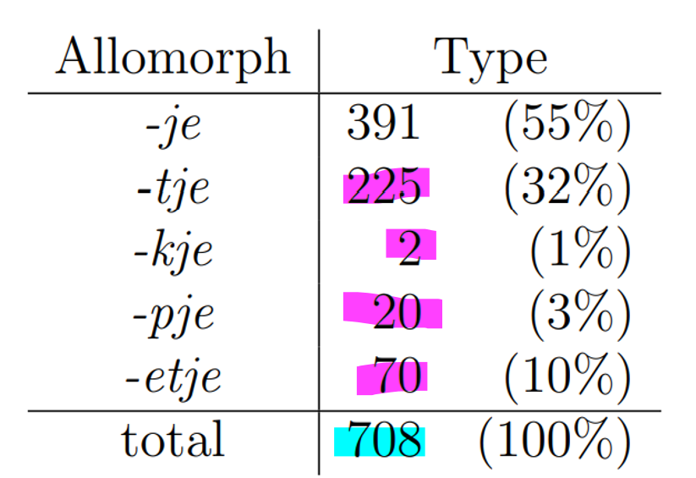
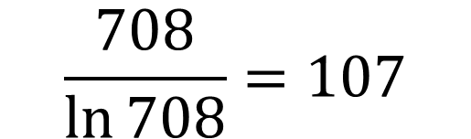
Analysis
Total: 708
$$\frac{708}{\ln{708}}=107$$
Exceptions: 317
Notes:
So, if we input 708 into the formula, we get a threshold of 107. Which means there can be a maximum of 107 exceptions to this rule.
The total amount of exceptions is actually 317, so the rule doesn’t even come close to being acceptable as a productive (efficient/useful) rule.

Slide 9
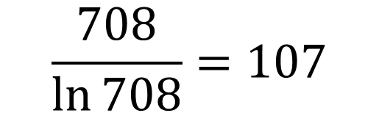


Analysis
Total: 708
$$\frac{708}{\ln{708}}=107$$
Exceptions: 317
Notes:
This “all diminutives end in –je” rule is out.
And if we were to try this for any of the other suffixes, the amount of exceptions would only become higher, so we can quickly conclude there isn’t one overwhelming rule like there is for the English past tense. In the case of Dutch diminutives, there must be a system of multiple rules.

Slide 10
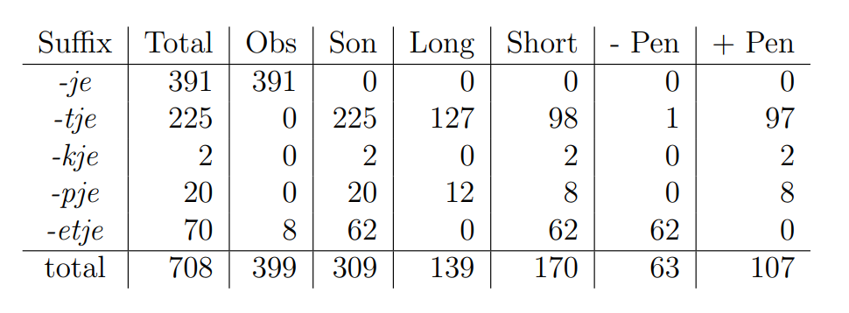



Analysis
Notes:
In order to find these rules, we split up the data with the features we previously discussed: Obstruency, Vowel Length, and Stress placement.
In the table we see the split between obstruent and sonorant in yellow, the split between long and short final vowels in red and in green the absence or presence of stress on the penultimate syllable.

Slide 11
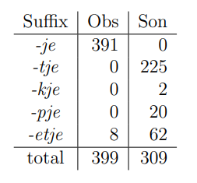
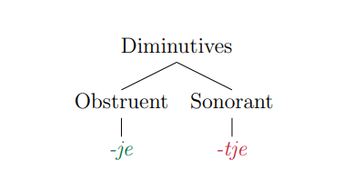

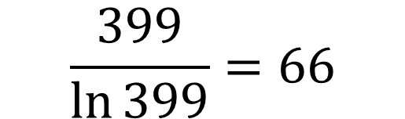

Analysis
N: 399
$$\frac{399}{\ln{399}}=66$$
Exceptions: 8
Notes:
Here we see a hypothesis with just a split between nouns with an obstruent ending and nouns with a sonorant ending. Let’s start with the rule on the left side, which would be something like ‘If a noun stem ends with an obstruent, add the –je allomorph”.
The total number of nouns with obstruent endings in our CDS dataset is 399. If we apply the TP to this number it returns a threshold of 66 maximum exceptions and in this case there are only 8 exceptions.

Slide 12



Analysis
N: 399
$$\frac{399}{\ln{399}}=66$$
Exceptions: 8
Notes:
Acceptable according to the TP.
Okay let’s move on to the right side of this hypothesis.

Slide 13



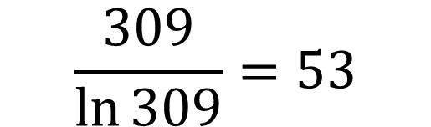

Analysis
N: 309
$$\frac{309}{\ln{309}}=53$$
Exceptions: 84
Notes:
The rule for this side would be something like “If a noun stem ends with a sonorant, add the –tje allomorph”.
Here the total number of nouns with sonorant endings is 309, which results in a threshold of 53.
The total number of exceptions is 84, so this rule is not acceptable according to the TP.

Slide 14
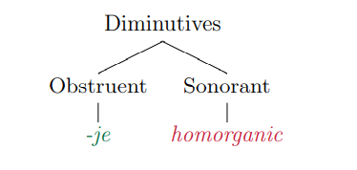


Analysis
N: 309
$$\frac{309}{\ln{309}}=53$$
-tje or
-pje or
-kje
Exceptions: 62
Notes:
The child might also consider a homorganic rule. Where we would take the allomorphs –pje and –kje as derivations of –tje, where they would be realised through place assimilation with the end of the stem.
So, in this case the rule would be something like: “If the noun ends with a sonorant, add a homorganic allomorph”
The threshold would be the same as for the previous hypothesis as it is still a rule for the sonorant set.
And in this case the total amount of exceptions is 62, which is still not acceptable. So now we move on to another subregularity.

Slide 15
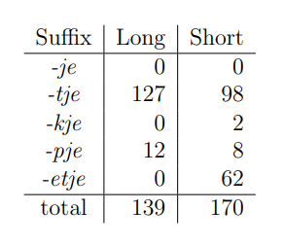
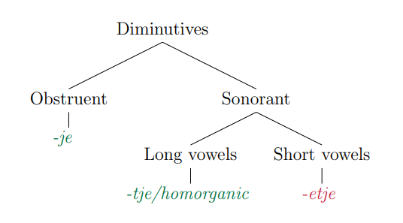

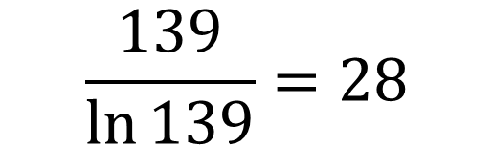

Analysis
N: 139
$$\frac{139}{\ln{139}}=28$$
Exceptions: 12 / 0
Notes:
We make another split in the sonorant set, between nouns with short and long final vowels.
In this hypothesis space we have a rule: ‘If a noun ends with a sonorant and has a long final vowel, add the –tje allomorph” OR the same rule, but then with the homorganic allomorphs included.
In the dataset there are 139 nouns with sonorant endings and long final vowels – this results in a threshold of 28. In the case of the –tje –rule. There are 12 exceptions and in case of a homorganic rule there would be none. So both are acceptable

Slide 16



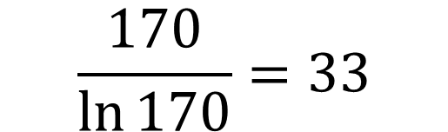

Analysis
N: 170
$$\frac{170}{\ln{170}}=33$$
Exceptions: 108
Notes:
Now we look to the rule all the way on the right. This rule would be: “If a noun has a sonorant ending and a short final vowel, add the –etje suffix”.
Let’s make the calculation, there are 170 nouns with sonorant endings and short final vowels, this gives us a threshold of 33. There are however 108 exceptions to this rule, so we should look for something else.

Slide 17
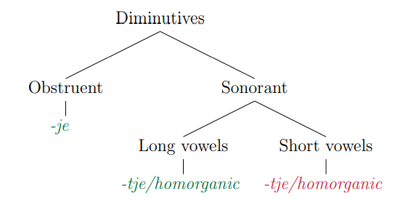




Analysis
N: 170
$$\frac{170}{\ln{170}}=33$$
Exceptions: 72 / 62
Notes:
Again, before moving on to another subregularity. Let’s explore all our other options in this subset. We could also test the –tje rule, and the homorganic rule in this subset.
The threshold is the same, as it is still the set of sonorant ending nouns with short final vowels, but in both these cases the number of exceptions is still too high. 72 and 62 respectively. So we have to move on to another division within this subset.

Slide 18
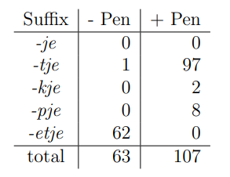
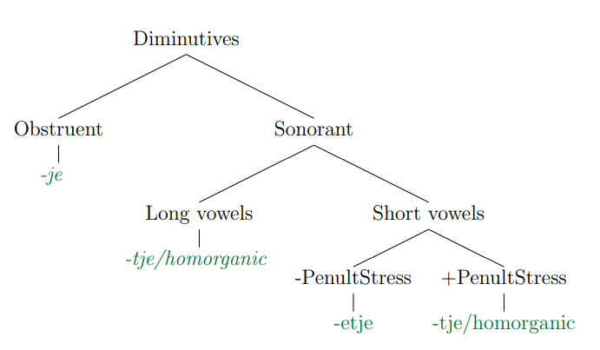
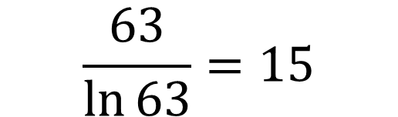


Analysis
N: 63
$$\frac{63}{\ln{63}}=15$$
Exceptions: 1
Notes:
So here we have another division, within the set of sonorant ending nouns with short final vowels. We make a division on stress placement between nouns with and without penultimate stress.
Here we test the nouns without penultimate stress, the hypothesis is something like: ‘If a noun has a sonorant ending, short final vowels and no penultimate stress, add the –etje allomorph’. The calculation would be made with the number 63, which gives us a threshold of 15, and there is only one exception so this rule is acceptable.

Slide 19
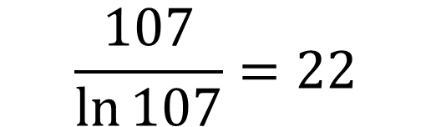



Analysis
N: 107
$$\frac{107}{\ln{107}}=22$$
Exceptions: 10 / 0
Notes:
And the final rule in this system
“if a noun has a sonorant ending, a short final vowel and penultimate stress, add –tje, or homorganic allomorph’
The threshold, calculated with the number 107, is 22. And there are either 10 or 0 exceptions, so this rule is acceptable as well.

Slide 20
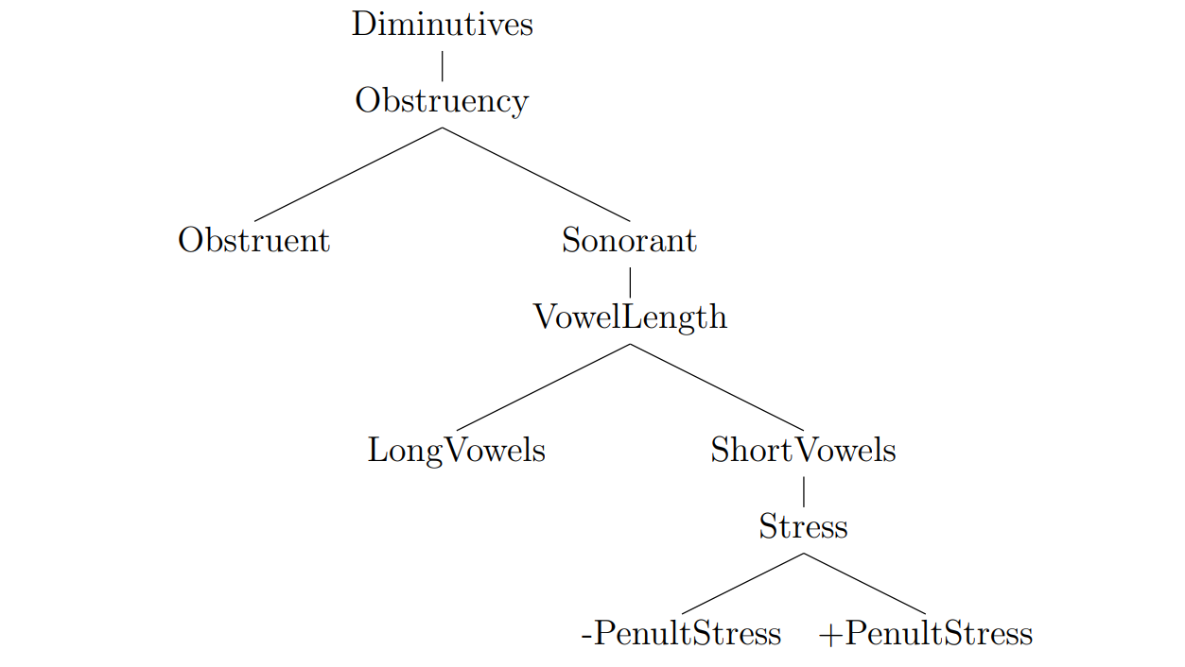



Analysis

Slide 21



Analysis
hek-je
“little fence”
-je
raam-pje
“little window”
-tje/-kje/-pje
lepel-tje
“little spoon”
lamm-etje
“little lamb”
-etje
-tje/-kje/-pje
Notes:
If we divide the Dutch diminutives in this way the rule will look like this.
Nouns ending with an obstruent get the -je suffix,
Nouns with a sonorant ending and a long final vowel get the -tje, -kje or -pje suffix.
Nouns ending with a sonorant, a short final vowel and no penultimate stress get the -etje suffix
And finally, nouns with a sonorant, short ending and penultimate stress get the homorganic suffix as well.

Slide 22
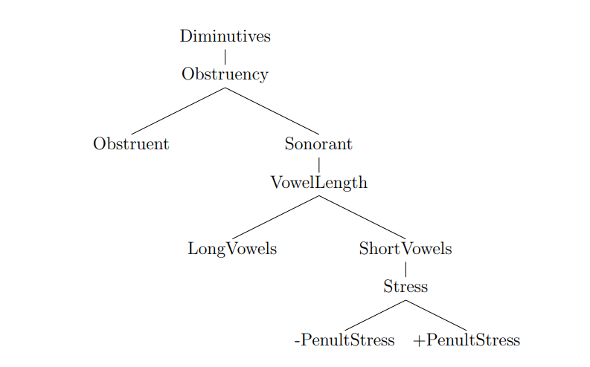




Analysis
-etje
Notes:
And according to the TP all of these rules are productive!
However, if we also take experimental studies about Dutch diminutives into account, there seems to be an inconsistency.
In this system it is proposed that there is a productive rule for the –etje suffix. So as there is a rule for its formation, -etje should be as easy to use and learn as all the other suffixes.

Slide 23
WUG-tests
WUG-test (van Tuijl 2020)
  geng → gengetje genkje/gengtje
  lem → lemmetje lempje
  termón → termonnetje termontje
Boersma WUG-test
  nan → nann-etje nan-tje
  ping → ping-etje pin-kje
  ming → ming-etje min-kje
  gol → goll-etje gol-tje
Boersma, T. (2018). Variability in the acquisition of allomorphs. PhD Dissertation, University of Amsterdam, Utrecht: LOT publications.
Notes:
The experimental studies I’m talking about are mainly in the form of the well-known WUG-test. If we look at the results of a recent and comprehensive WUG-test conducted by Tiffany Boersma at the University of Amsterdam, we see that children struggle much more with the acquisition of the –etje suffix as compared to the other suffixes.
And what is even more interesting, Boersma also conducted this experiment with adults for control reasons. And found that even adults struggle when applying the –etje suffix.

Slide 24
WUG-tests
Adult participant results
Consistent use of –etje - 5%
Consistent use of –tje, -kje or –pje - 23%
Inconsistent use of both strategies - 72%
Notes:
The adult participants of the WUG-test used varying strategies when it came to words that had the –etje suffix as the target – so words that had sonorant endings, short final vowels and no penultimate stress.
This was enough reason to look for another system that might capture the Dutch diminutive system better.

Slide 25
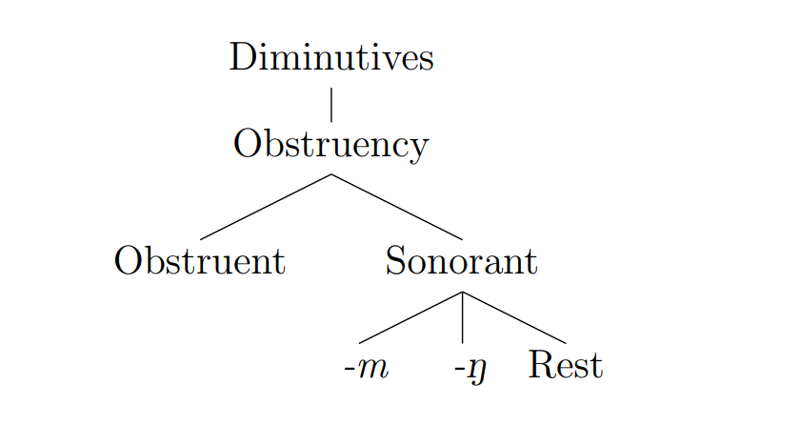
Alternative tree
Notes:
So, because the results of this empirical research present an inconsistency in the previous system, we went back up the tree in the system that was found, to search for another solution. And this is where the simple features ending with -m and ending with -ng from all the way in the beginning of this presentation make a comeback.
We can use these features to make a division within the nouns in the sonorant set.
This would simplify the tree, because we can throw out vowel length and stress placement

Slide 26
Alternative tree
hek-je
“small fence”
-je
raam-pje
“small window”
-pje
-kje
-tje
lepel-tje
“small spoon”
koning-kje
“small king”
Notes:
And the suffixes can be divided like this.
Obstruent nouns still get the –je allomorph
Sonorant ending nouns that end with an –m get the –pje allomorph
Sonorant ending nouns that end with –ng get the –kje allomorph
And the rest of the sonorant set gets the –tje allomorph

Slide 27




Alternative tree
-je
-pje
-kje
-tje
Notes:
And these rules are also productive according to the tolerance principle.
And what’s best about this system, is that is has no rule for the –etje suffix. Now we are not just leaving out all the –etje diminutives, they are still accounted for in this system. They are just all exceptions to the other rules here. And the –etje suffix being an exception would perfectly explain why it is hard to learn for children, they would need to learn them all individually.

Slide 28










Alternative tree
-je
-pje
-kje
-tje
Notes:
Now we finally have a productive rule system for the Dutch diminutives. That is correct according to the Tolerance Principle and also aligns with experimental research!
We know that we make a pretty bold claim by stating, with this last tree, that stress placement and vowel length don’t play a role in diminutive formation. Follow- research is still needed. We would like to perform more WUG-tests, that would be specified more towards the –etje diminutives and bisyllabic words. In the WUG-test we performed last year we tested one such word, ‘termon”, as I mentioned. And it would be great to test similar words, like ‘badón’ or ‘katíl’ with both children and adults.
Thank you for listening, I’d be happy to answer any questions you may have!

Slide 29
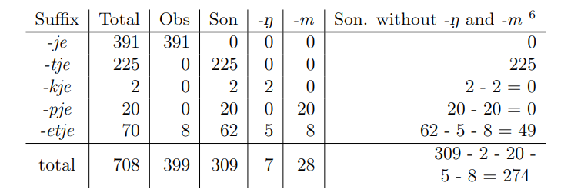
Extra table - -ng and –m (cds)
Notes:
Extra slides

Slide 30
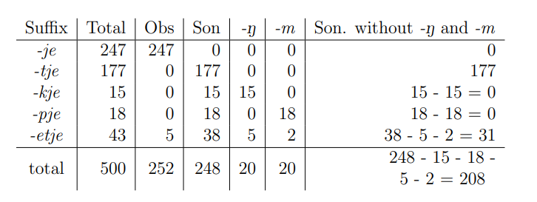
Extra table – 500 most freq. nouns

Slide 31
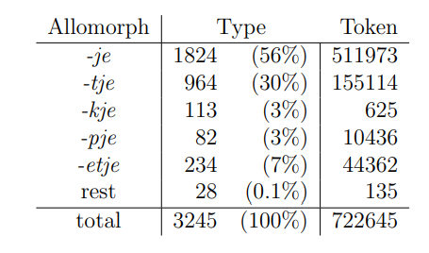
Extra table – full corpus vs. cds corpus

